Slide 1

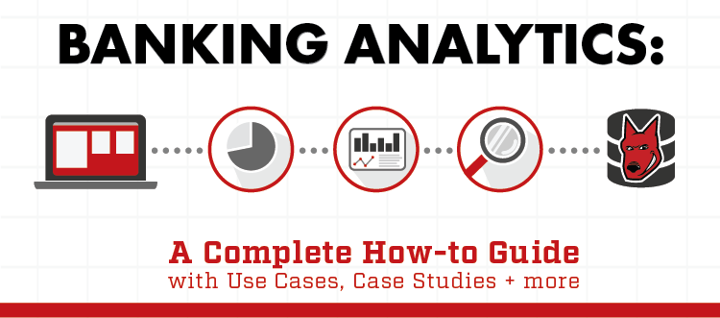
BANK ANALYTICS
PRESENTED BY (P110- GROUP 4):
HEENAL PATEL
VRUTTI VEGAD
YASHITA PARMAR
VISHAL RATHORE
KIRAN
KISHORE
VIJAY YEDURU

Slide 2
Banking analytics, then, refers to the spectrum of tools available to handle large amounts of data to identify, develop, and create new business strategies. It refers to the use of artificial intelligence and machine learning being applied to customer data to make decisions in the banking sector. Data is analyzed, trends identified, and predictions made. The major revenue stream for banks is selling loans, and this makes up the highest percentage of a bank’s income. However, despite the potential returns associated with these loans, it can also be an extremely risky venture for banks. Banking analytics tools are used by financial institutions to categorize their customers in accordance with their risk levels.
INTRODUCTION

Slide 3
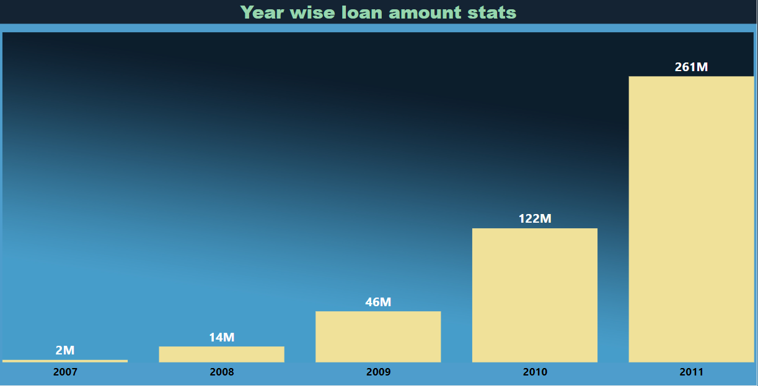
Year wise loan amount Stats
﻿Sum of loan_amnt trended up, resulting in a 11,638.36% increase between 2007 and 2011.﻿﻿ ﻿﻿ ﻿﻿Sum of loan_amnt started trending up on 2007, rising by 11,638.36% (258287300) in 4 years.﻿﻿ ﻿﻿ ﻿﻿﻿Sum of loan_amnt jumped from 2219275 to 260506575 during its steepest incline between 2007 and 2011.﻿﻿ ﻿﻿ ﻿

Slide 4
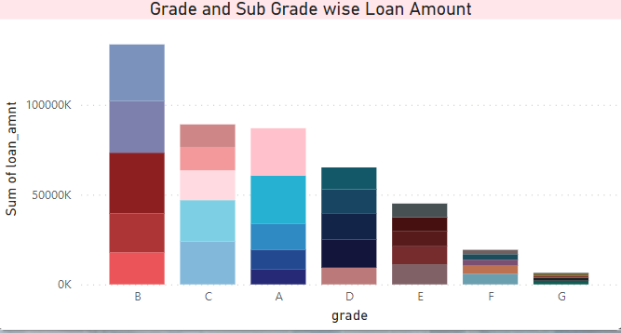
Grade and sub grade wise revol_bal
﻿ ﻿At 133651350, B had the highest Sum of loan_amnt and was 1,991.02% higher than G, which had the lowest Sum of loan_amnt at 6391675.﻿﻿ ﻿﻿ ﻿﻿[]﻿﻿ ﻿﻿ ﻿﻿B accounted for 29.99% of Sum of loan_amnt.﻿﻿ ﻿﻿ ﻿﻿Across all 7 grade, Sum of loan_amnt ranged from 6391675 to 133651350.﻿﻿ ﻿﻿ ﻿

Slide 5
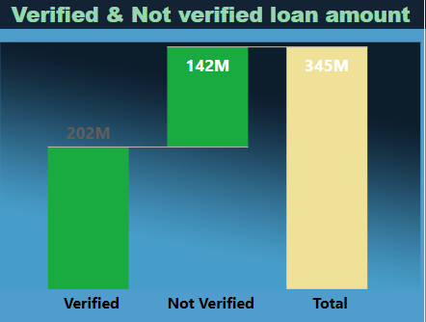
Total Payment for Verified Status Vs Total Payment for Non Verified Status
﻿ ﻿﻿Count of total_acc for Not Verified (16,921) was higher than Verified (12,809).﻿﻿ ﻿﻿ ﻿﻿Not Verified accounted for 56.92% of Count of total_acc.﻿﻿ ﻿﻿ ﻿﻿Verified had 12,809 Count of total_acc and Not Verified had 16,921.﻿﻿

Slide 6
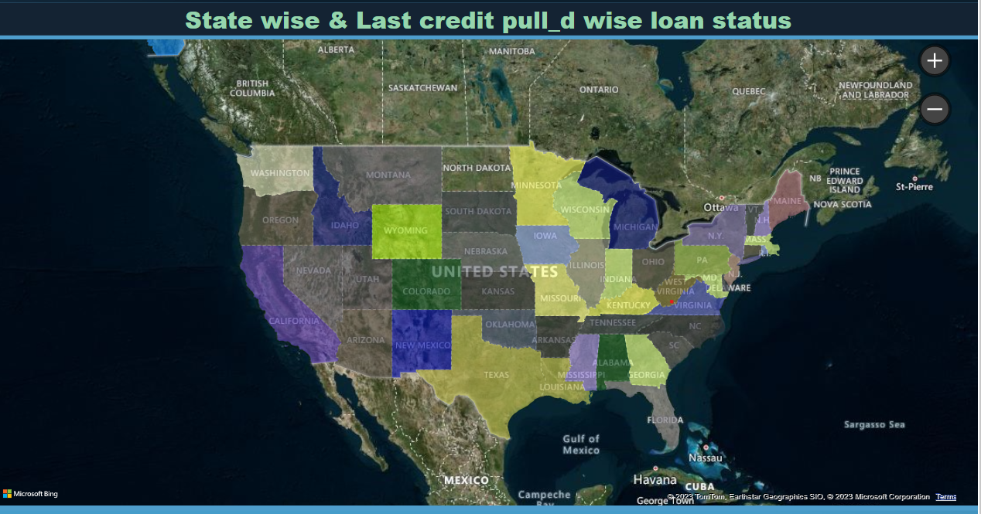
State wise and last_credit_pull_d wise loan status
Based on state wise loan status almost all the states have fully paid the loan amount while only few state loans have been charged off.

Slide 7
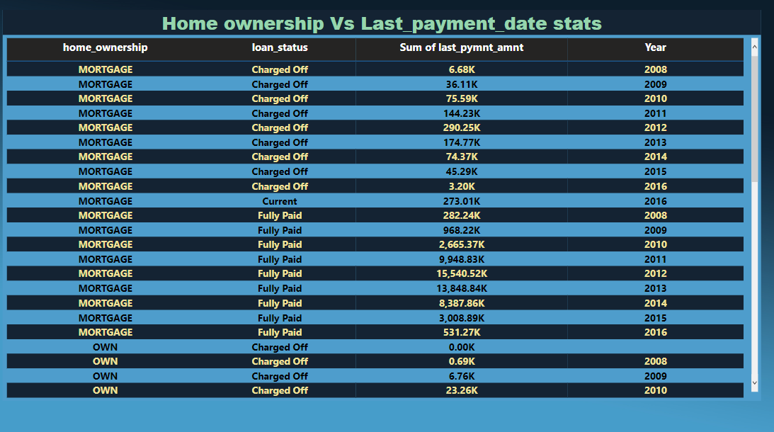
Home ownership Vs last payment date stats
In terms of home ownership wise loans, the highest loan type is mortgage and least one is own.

Slide 8
CONCLUSION
The loan amount is increasing year by year.
B grade type loan amount is the highest.
Verified loan account is lesser then the non verified one.
Most of the state have paid their loan fully.
The most loan taker for home ownership are the mortgage one .

Slide 9
THANK YOU…!!!

